Slide 1



Ministry:
पृथ्वी विज्ञान मंत्रालय
Ministry Of Earth Sciences
Nodal Center:
Vardaman College Of Engineering
Problem Statement: SIH1656
Development of a mobile application to provide recreational suitability information of beach locations across India.

Slide 2


TEAM BENZENE 2.0
Jalpaiguri Government Engineering College, West Bengal
KSHITIJ
Helping tourists be safer, and beaches be more prosperous

Slide 3

BENZENE 2.0
has been created in keeping with the aim of The Ministry of Earth and Sciences to enable tourists to remain safe while enjoying their favourite activities, by the dint of prompt alerts, user-friendly interface and easy access to emergency services.
Kshitij

Slide 4








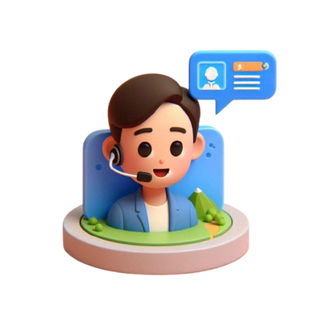

BENZENE 2.0
How Kshitij streamlines
your beach venture?
is a geo-encoded platform that leverages new age tools to classify beach locations and activities safe or unsafe based on inputs from INCOIS API along with time series data about weather conditions, which are then leveraged using an apt machine learning model.
1. Safety Profiling
Kshitij leverages the abilities of machine learning to classify locations and activities into categories of safe, unsafe or moderate, so users can make quick decisions.
2. Geospatial Visualization
Fully furnished Geospatial maps are integrated into the very system of the app to make the visibility of safe and troubled zones easier.
Kshitij
3. Prompt Alerts
With a single click, users are empowered to share their live locations with their SOS contacts, aiding both families and NDRF in cases of emergencies.
4. Crowd Reporting
Allowing users to generate their own reports based on their experiences on a beach, properly moderated by community notes, empowering users to act like on-ground reporters.
5. Real-Time Info
Our solution seamlessly integrates requests to up-to-date relevant APIs like INCOIS, WeatherBit etc to let the user be be wary of any environment /weather turmoil.
6. Furnished with AI
Our very own travel planner chat bot leverages latest fine-tuned Gen AI models to provide one-of-a-kind interactive experience to users planning their future beach trips.
7. Community
A holistic and inclusive community, which is properly moderated to ensure tourists can make acquaintances close to their places of visit..
8. Multi-Lingual Support
As we are dedicated to building an inclusive solution for the diverse space of our nation, we intend to provide a multi-lingual support for users across the country.
Hi! I am Kshitij-Mitra.
Your personal AI Travel Planner

Slide 5
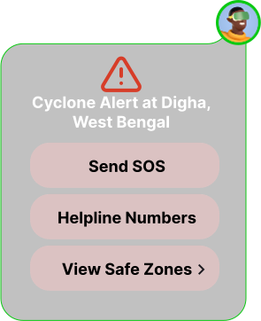
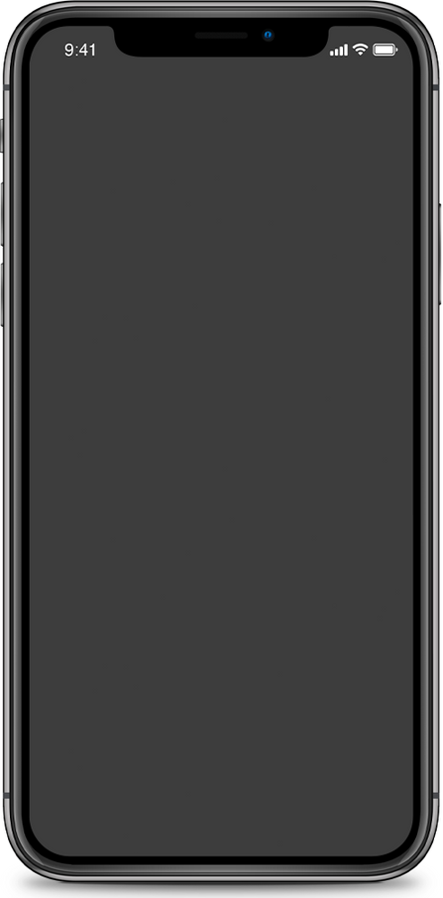

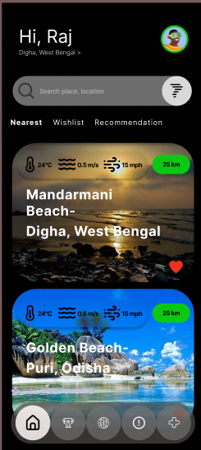





















BENZENE 2.0
IMPACTS &
BENEFITS
Social
User-friendly interface: customized recommendations
Tourist Safety: Provides timely alerts and precautions, potentially saving lives and preventing accidents.
Map visualization
& data graphics
Public Awareness: Informs users about oceanic conditions, fostering a safety-conscious society.
Economic
Real-time
weather updates
Pop up for crisis
situations
Boost in Tourism: Safer tourism attracts more visitors, increasing revenue for local businesses.
Nearby safe
activities suggestions
Cost Savings: Prevents accidents, reducing emergency response and healthcare costs.
Community posts &
experience sharing
Chatbot:
Recreational Travel Planner
Environmental
Weather-based
precautions
Multilingual
Support
Sustainable Tourism: Saves resources helping tourists pick sustainable recreational activities, thus preventing environmental degradation.
Beach Patrol
and safety zones
Safety guidelines
for tourists
Data-Driven Decisions: Uses real-time data to promote responsible use of natural resources and sustainable practices.

Slide 6

BENZENE 2.0
Why to choose Kshitij app?
Available Solutions in the market | Realtime weather & Tide Information | Geo spatial Map Visualization | Realtime Alert Notification | Live Suitability Status | Live Location Sharing & Safe zone | AI Powered ChatBot & Travel Planner | Community Feature & user Generated Alerts
Kshitij (our app)
My Coast |  |  | ❌ | ❌ | ❌ | ❌ | ❌
Beach Safe India |  |  | ❌ |  | ❌ |  | ❌
Lifeguard Connect |  | ❌ |  | ❌ |  | ❌
Beach Flags | ❌ |  | ❌ | ❌ | ❌ | ❌ | ❌

Slide 7

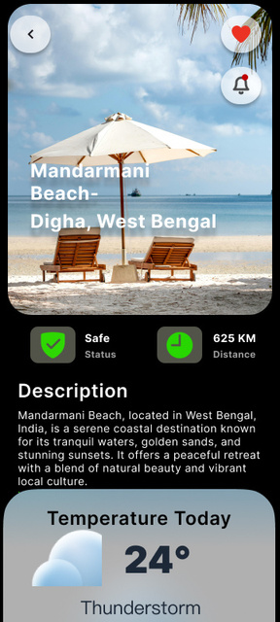
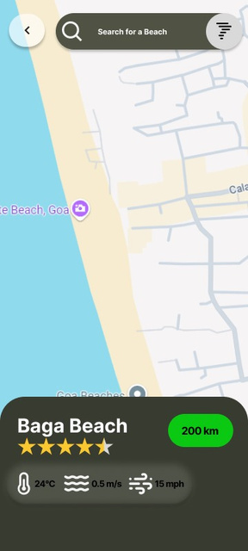
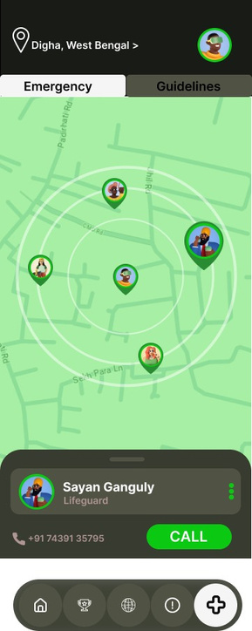
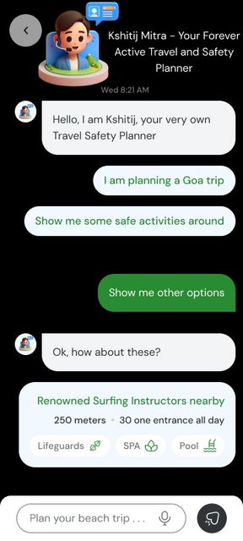
BENZENE 2.0
APP UI
Presenting Kshitij, a one-stop platform to guarantee safety and best experiences for all beach tourists across the country by the dint of APIs, Machine Learning and Geospatial visualization of target locations.
Beach Landing Page
Beach Suitability Map
Instant Helpline
Chatbot - Travel Planner

Slide 8
















BENZENE 2.0
APP WORKFLOW
Beach Info including all weather parameters
Fit data
Final
Data stored RAT file
Retrieve weather
Info
Base
ArcGIS API
Device
Weather Graph
SafeZone/
Geospatial map
visuals
Location fetch
Weather Api
INCOIS
Database
Found nearby beach data
Ensembling of Results
ML MODEL
Prediction
Alert visual
API Alert
Notification
Activity safety
advice
Alert API

Slide 9







BENZENE 2.0
ML MODEL FLOWCHART
Weather Api
INCOIS
Fetch Data for past 10 Days
Preprocessing
& EDA
Feed Forward Neural Network for Weather Data
Classification
Final Output
Risk Prediction
Decision Tree Model
Summary Generation

Slide 10
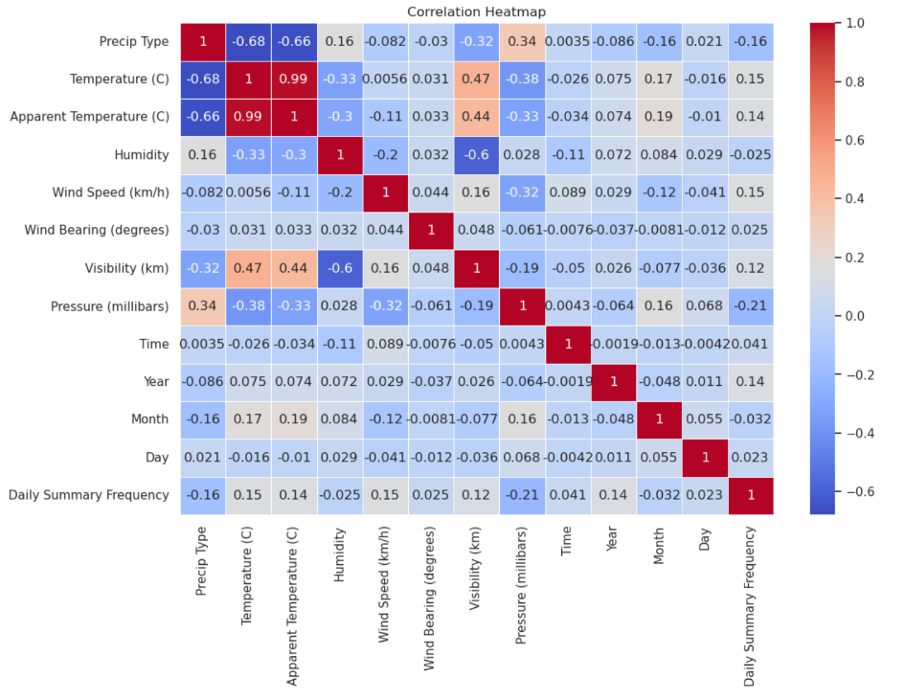
BENZENE 2.0
Correlation between different weather parameters

Slide 11
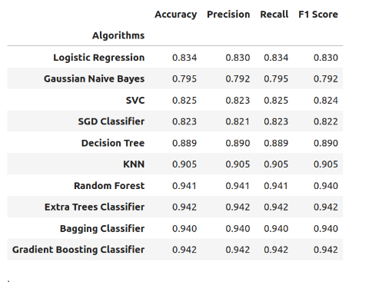
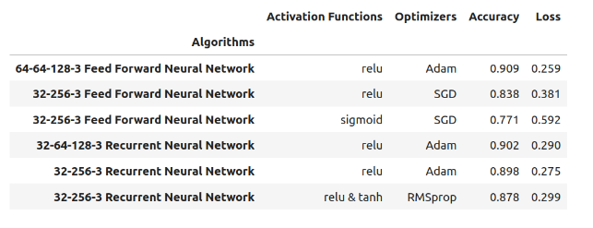
BENZENE 2.0
Comparison between different classification models over the dataset

Slide 12

BENZENE 2.0
Keeping in mind, the usability and accessibility needs of the people across the nation, we have provided for a convinient multi-lingual AI powered travel planner bot
Kshitij Mitra

Slide 13
BENZENE 2.0
PARAMETERS | OUR SOURCE
Ocean Current, pH level of the water, Salinity level , Temperature of the water, Concentration of dissolved oxygen in the water, Concentration of dissolved methane in the water, Partial pressure of CO2 in the air, Partial pressure of CO2 in the water, Chlorophyll concentration in the water, Presence of bacteria or algae, Turbidity of water, Concentration of coloured dissolved organic matter (CDOM) in the water | INCOIS API
Real-time alerts for Tsunami | Tsunami Threat Map API (provided by INCOIS)
Real-time alerts for Cyclone | Storm Surge Cyclone Data API (provided by INCOIS)
High and low tides, tidal patterns | Astronomical Tides API (provided by INCOIS)
Air temperature, pressure, wind speed, wind direction, cloud cover, humidity, precipitation, sea level, swell height, visibility | StormGlass API
Satellite Images | Google Earth Engine
Flights and Hotels Information | Serp API
Alert Zones | WeatherBit API
Map | Google Map SDK
Generating GeoJSON file from shape filled maps | QGIS API
Crowd Density | Google Traffic API
Travel Bot Base Model | Hugging Face LLAMA 3

Slide 14









BENZENE 2.0
TECHNOLOGY STACK
Application
Backend
Database
Cloud
Geospatial
API
ML and AI
Android
Native app development using
Android Studio
Kotlin
XML
PostgreSQL
Firebase Cloud Messaging
(for push notifications using )
INCOIS
Weatherbit
ArcGis
Stormglass
SerpAPI
Google Traffic
QGIS
Pytorch
(for machine learning models)
Hugging face Langchain
for natural language processing
Llama3.1
Amazon Web Services
(for hosting and services like EC2 for hosting)
ArcGIS
(for interactive geospatial map visualization)
Django
Python
Cloud
Python
Firebase
Langchain
INCOIS API
Pytorch
PostgreSQL
ArcGIS API
Android

Slide 15

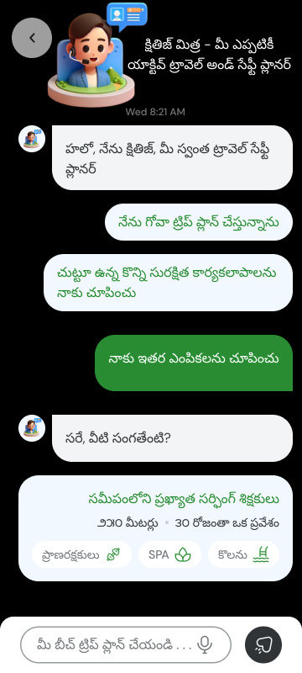
BENZENE 2.0
No Language Barrier!
Supports 15+ Indian Languages
An App for everyone

Slide 16
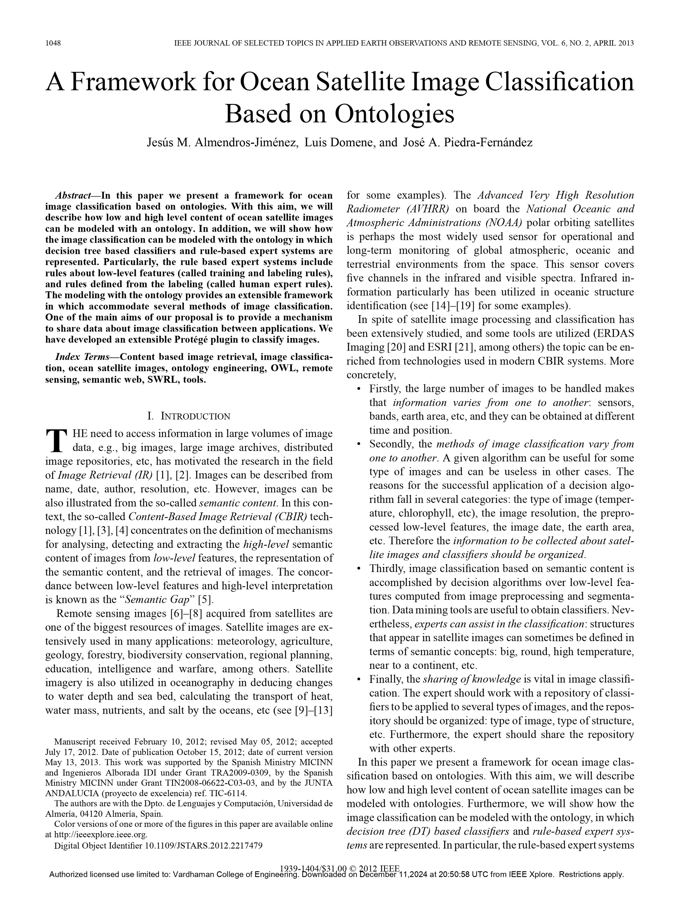
BENZENE 2.0

Slide 17



BENZENE 2.0
How we are integrating satellite images in our app?
Input Satellite Image using Google Earth Engine
Use RASTERIO for loading and reading the file
Convert the 2D coordinates of the satellite map into real-time geospatial coordinates using Coordinate Reference System (CRS)
Map the real-world coordinates into pixel indices.
Store these values in the Database for future use
Match Predicted Hex Code with Legend Values
Predicting a color and generating Hex Code on that
Extract features from pixel indices

Slide 18
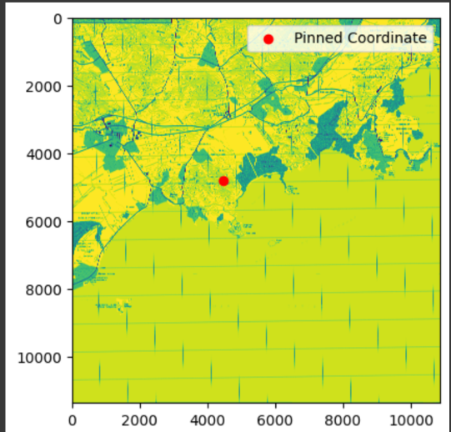
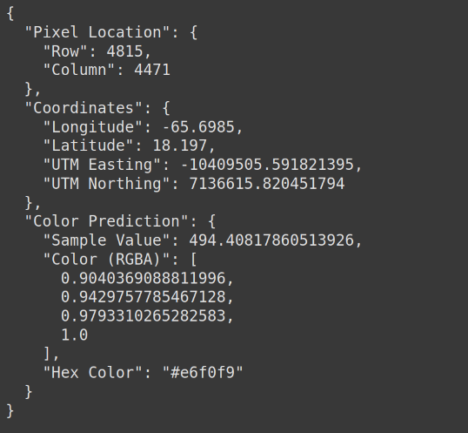
Hex-code Generation for Pixels Based on Location Using Geo-Satellite

Slide 19
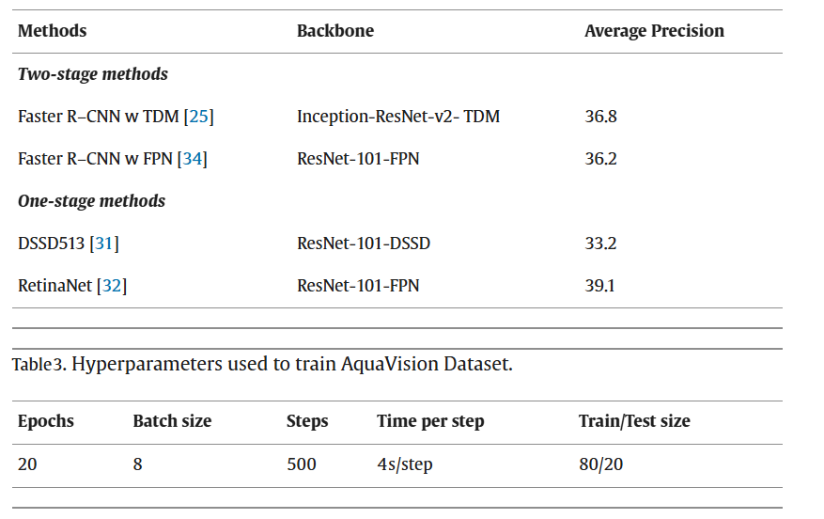
Bio Hazard and Risk Detection Based on Ocean Color - Our Novel Approach

Slide 20
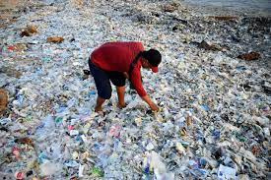

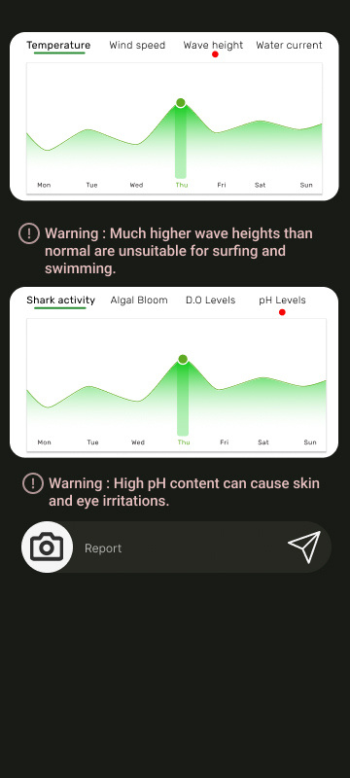
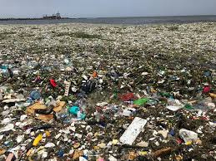
BENZENE 2.0
Don’t blame, Contribute
Have a grievance about your nearest beach? Just make a report and make sure its noticed by the necessary authorities.
Make your beach journey cleaner and happier, and thus, help yourself and others at the same time.

Slide 21




BENZENE 2.0
Don’t have KSHITIJ but do have sense!
if you don’t have KSHITIJ app installed in your device you can still use KSHITIJ grievance submit portal for submitting your report against the inappropriate

Slide 22












BENZENE 2.0
FEASIBILITY & VIABILITY
Technical Feasibility
Ensures real-time data retrieval with minimal delays.
Critical for timely and accurate safety alerts.
High accuracy models for predicting beach suitability.
Efficient algorithms optimized for mobile platforms.
Legal Feasibility
Compliance with data protection regulations to safeguard tourist privacy.
Business Feasibility
Market Demand
Partner with local businesses (e.g., hotels, restaurants) and travel agencies
High demand for safety information among tourists, ensuring widespread adoption.
Resolution
Scale
To scale for future load we propose Horizontal scaling techniques which works effectively with multiple instances. To achieve this we deploy using EC2 amazon webservice which provides the benefit of elasticity.
Unique integration of real-time data with user-friendly geospatial mapping, setting the app apart from existing solutions.

Slide 23
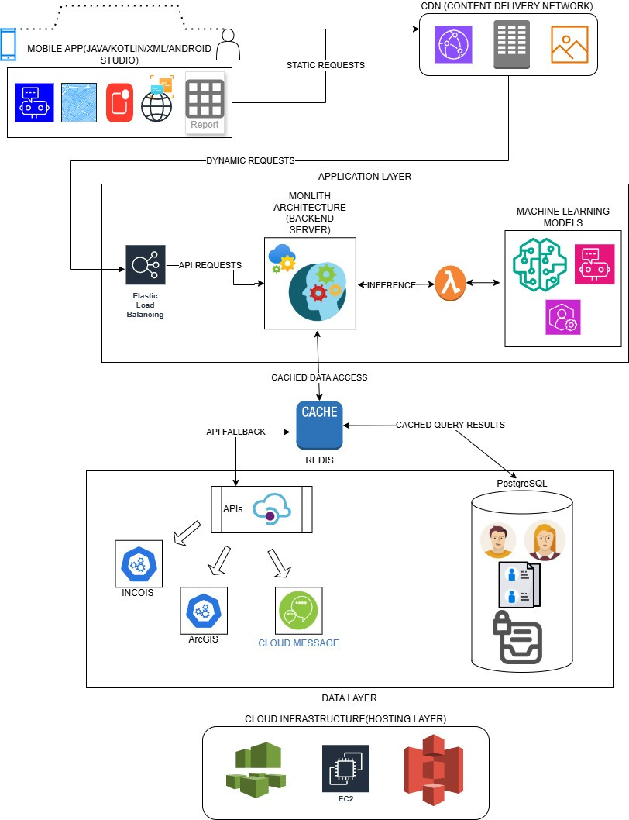
BENZENE 2.0
High Level System Design

Slide 24
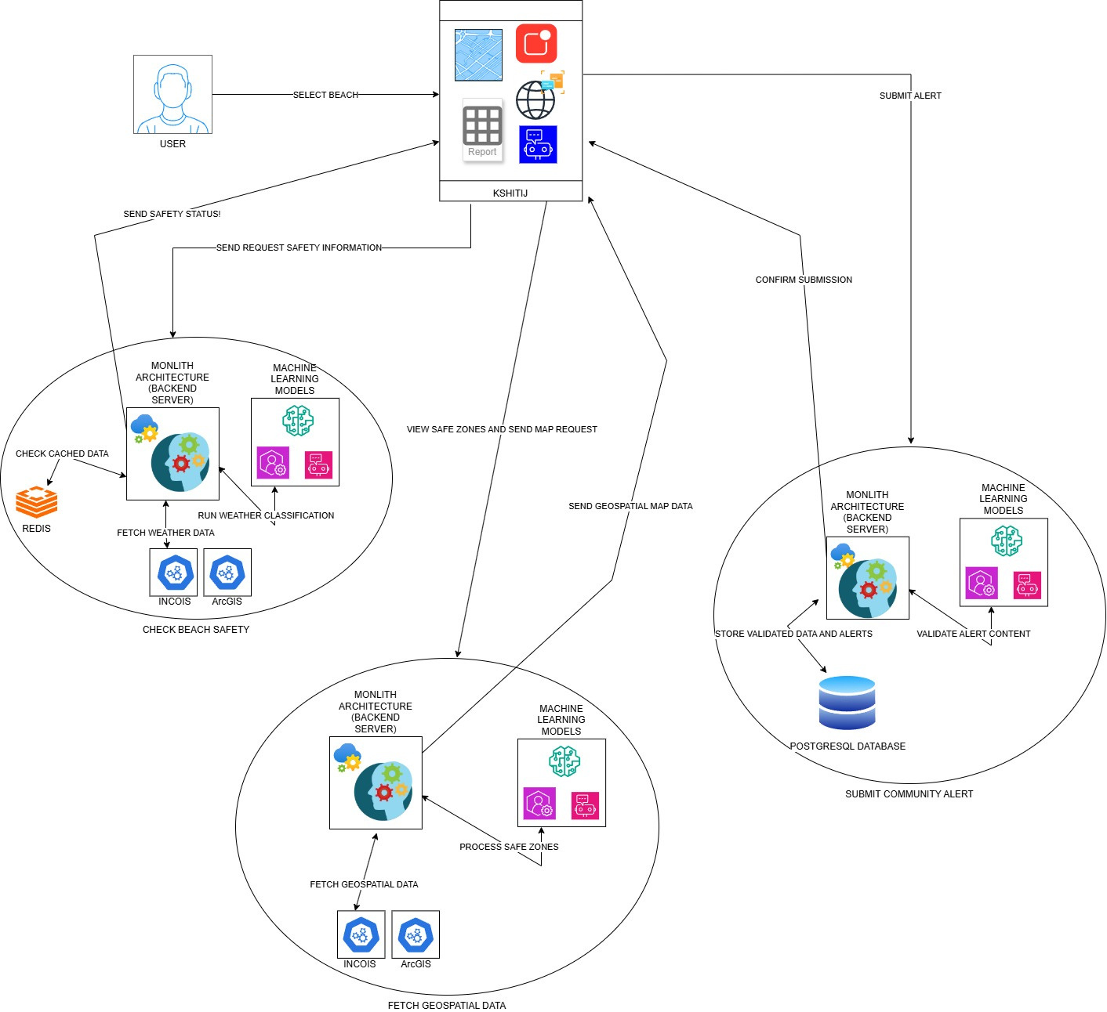
BENZENE 2.0
User Defined System Design

Slide 25
BENZENE 2.0
Justifying Calculations
Assumptions for the Revised Project :
Server Requirements :
Active Users: 150 crores active Indian users.
Daily Usage: 50% of users use the system daily → 75 crores daily active users.
Requests per User per Day: Each user makes 50 requests per day.
Media Requests: 40% of requests include media.
Data Retention Period: Data is stored for 5 years.
Average Request Size:
ID: 64 bytes
Text: 150 bytes
Media: 1 MB (for 40% of the requests)
Step 1: Calculate Daily Storage
Query Per Second (QPS) Calculation :
1 Non-Media Requests (60%):
3750 crores × 60% × 214 bytes (ID + Text) ≈ 482.4 GB/day
2. Media Requests (40%):
3750 crores × 40% × 1 MB=1500 TB/day = 1.5 PB/day.
3. Total Daily Storage:
1.5 PB+482.4 GB≈1.5 PB/day
Step 1: Calculate Total Daily Requests
Total Daily Requests = Daily Active Users × Requests per User =
75 crores × 50 = 3750 crores requests/day
Step 2: Calculate Queries(Requests) Per Second
Step 2: Calculate 5-Year Storage
QPS = Total Daily Requests ÷ Seconds in a Day =
3750 crores/(24 hours×3600 seconds) ≈ 43,400 QPS
5-Year Storage = Daily Storage × 365 days × 5 years =
1.5 PB × 365 × 5 = 2737.5 PB (or 2.74 Exabytes)
*****1 Petabytes = 10^-3 Exabytes
Step 3: Peak QPS : Peak QPS (Queries Per Second) refers to the maximum number of requests or queries a system is expected to handle in one second during its busiest time.
Assuming peak usage is 2 times the average:
Peak QPS = 2 × 43,400 ≈ 86,800 QPS
Server Requirements :
QPS per Server: 15,000 QPS per server.
Total Servers Needed:
Servers=Peak QPS / QPS per Server = 86,800/15,000 ≈ 6 servers

Slide 26
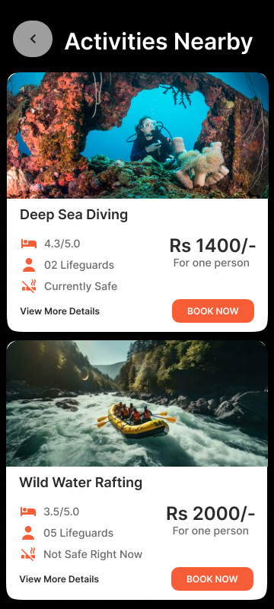
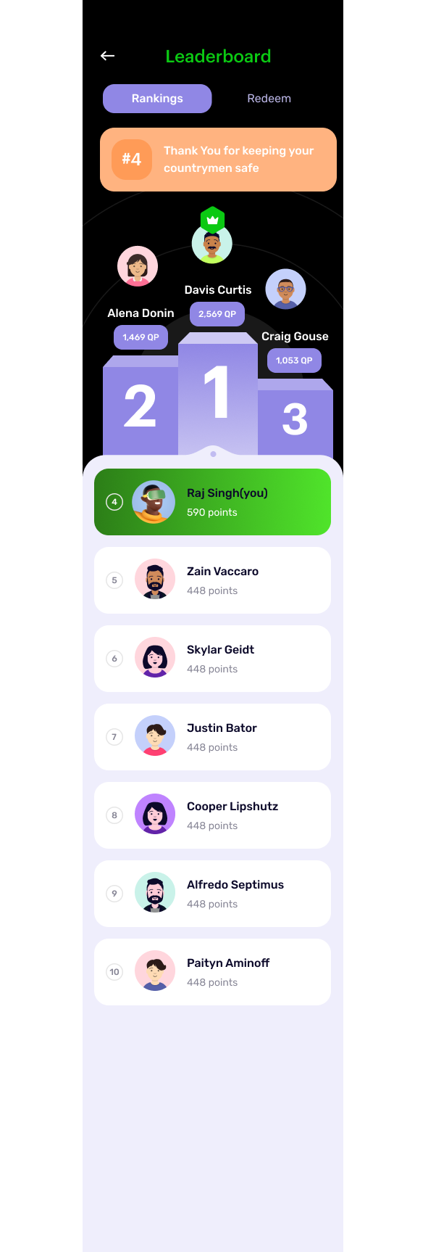
BENZENE 2.0
Future Scope and Business Plan
Beyond the realm of traditional alerts and safety, Kshtij peromises to be an overall boost for the local economies near the beaches across India, while taking care of our of financial viability.
Report alerts and anomalies and after thorough verification, you can get rewards that can later be redeemed at small and major businesses across the country.
Kshitij plans to be a one stop application to let local businesses promote themselves on national scale, while maintaining complete transparency about our sponsor and legal obligations.

Slide 27




BENZENE 2.0
India’s Blue Economy -
An Untapped Goldmine
As India progresses in developing its blue economy, it has the opportunity to unlock significant economic and environmental benefits. We can use our app for the following purposes :
Technical Feasibility
Environmental conservation
Job Curation
Economic Growth
Business Growth

Slide 28
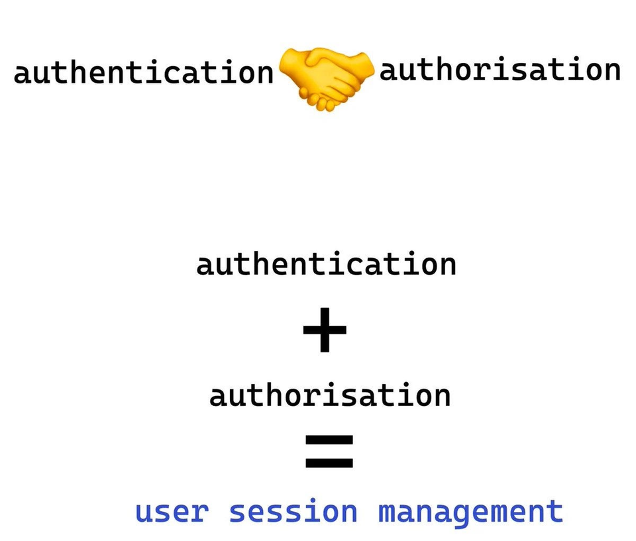
BENZENE 2.0
Security & Data Integrity
Keep you safe at all times(without stalking...)
UUID v4 (Universally Unique Identifier version 4) is a type of identifier commonly used in cybersecurity and software development to uniquely identify objects or entities in a system. It is a *randomly generated* identifier and is part of the broader UUID standard defined by [RFC 4122].
Making use of UUID based mapping, we do not need real-time location at all times, instead we map your locations based on major zones, thus preventing load on our application while also helping us push the most relevant alerts.

Slide 29
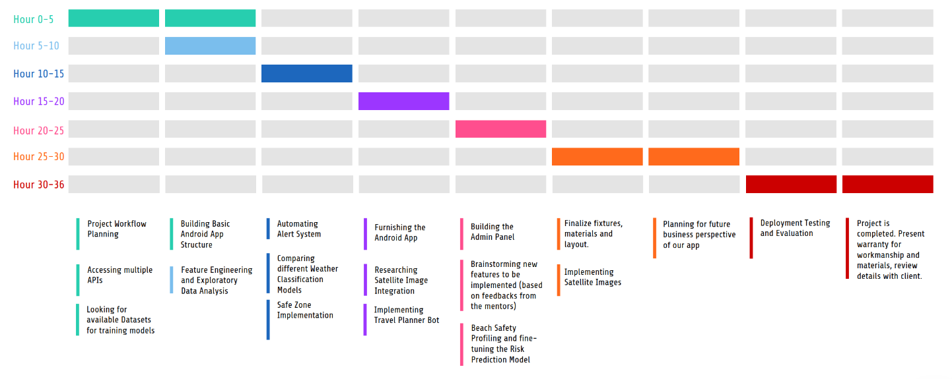
PROJECT TIMELINE
Completed
Projected

Slide 30
BENZENE 2.0
NAME | EMAIL | PhNO
Zaid Mahmud | itssubi76@gmail.com | 7595995214
Sayan Ganguly | sayanganguly128@gmail.com | 7903940824
Urnisha Paul | urnishapaul05@gmail.com | 7908659711
Diptesh Karmokar | dk2615@cse.jgec.ac.in | 8900348163
Sampurno Sarkar | sampurnosarkar.ind@gmail.com | 7439135785
Rupam Sadhukhan | rsadhukhan859@gmail.com | 8335974336
MENTOR NAME | EMAIL | PHNO
ANUBHAB SARKAR | anubhabsarkarofficial@gmail.com | 7044312862

Slide 31
Thank You!

